Slide 1
STATIC,FINAL AND INNER CLASS

Slide 2
STATIC

Slide 3
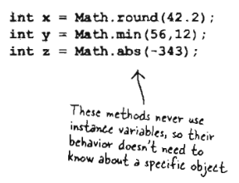
Math
Methods in Math class do not use any instance variable
Because the methods are static you do not need to have an instance Math.
All you need is Math class

Slide 4
Difference static and regular method
Keyword static lets a method run without any instance of class

Slide 5
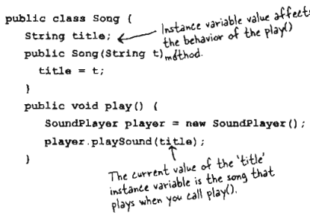
Example regular

Slide 6
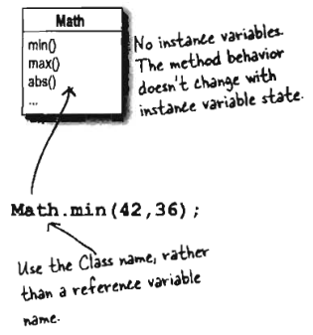
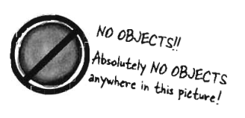
Example static
Public static int min (int a, int b){
//return lesser of a or b
}

Slide 7
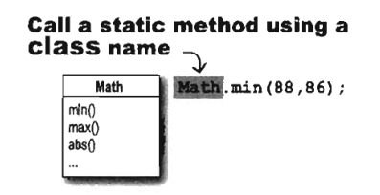
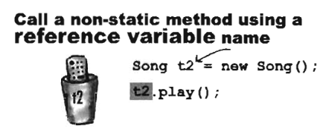
Comparison

Slide 8
Rule
You can not call non static variable from inside static methods*
You can not call non-static methods from inside static methods*

Slide 9
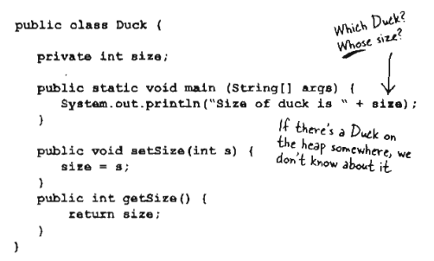
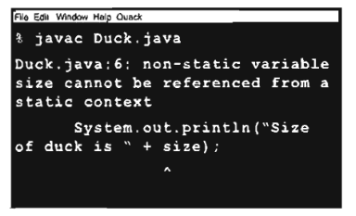

Slide 10
Static variable
Static variable gives you: a value shared by all instances of a class
In other words, one value per class, instead of one value per instance.

Slide 11
Example
public class Duck{
private in size;
private static int duckCount = 0;
public Duck(){
duckCount++;
}
}

Slide 12
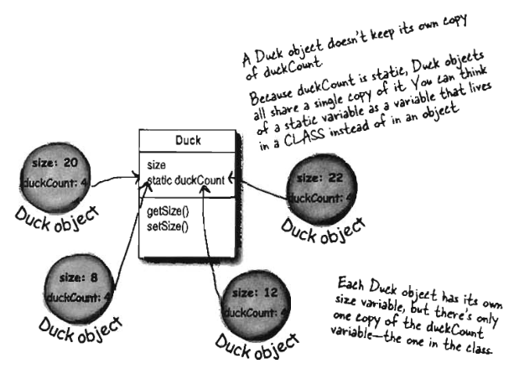

Slide 13
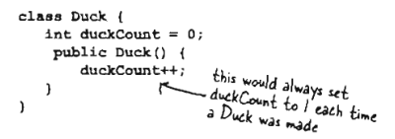
Wrong way to count duck

Slide 14
Summary static
Static variable are shared
All instance of same class share single copy of static variable

Slide 15
FINAL

Slide 16
Final keyword
Java’s final keyword has slightly different meanings depending on the context
In general it says “This cannot be changed.”

Slide 17
Final data
Constant:
  It can be a compile-time constant that won’t ever change.
  It can be a value initialized at run time that you don’t want changed.
In Java, these constant must be primitive type and with final keyword

Slide 18
Final on object
When final is used with object references rather than primitives, the meaning can be confusing.
With a primitive, final makes the value a constant, but with an object reference, final makes the reference a constant.
Once the reference is initialized to an object, it can never be changed to point to another object
However, the object itself can be modified

Slide 19
Note
By convention: fields that are both static and final (that is, compile-time constants) are capitalized and use underscores to separate words
Example:
public static final RHO_NUMBER = 247;

Slide 20
Some code

Slide 21
Comment
Just because something is final doesn’t mean that its value is known at compile time.
This is demonstrated by initializing i4 and INT_5 at run time using randomly generated numbers.
Notice the difference between making a final value static or non-static.
The difference is shown when you run the program. Note that the values of i4 for fd1 and fd2 are unique, but the value for INT_5 is not changed by creating the second FinalData object.
That’s because it’s static and is initialized once upon loading and not each time a new object is created.

Slide 22
Cont.
just because v2 is final doesn’t mean that you can’t change its value.
Because it’s a reference, final means that you cannot rebind v2 to a new object.

Slide 23
Final argument
You can read the argument, but you can’t change it.
Notes:
This feature is primarily used to pass data to anonymous inner classes.

Slide 24
Example
class Gizmo {
public void spin() {}
}
public class FinalArguments {
void with(final Gizmo g) {
//! g = new Gizmo();
// Illegal -- g is final
}
void without(Gizmo g) {
g = new Gizmo();
// OK -- g not final
g.spin();
}
// void f(final int i) { i++; }
// Can’t change
// You can only read from a final primitive:
int g(final int i) { return i + 1; }
public static void main(String[] args) {
FinalArguments bf = new FinalArguments();
bf.without(null);
bf.with(null);
}
}

Slide 25
Final method
To put a “lock” on the method to prevent any inheriting class from changing its meaning.
This is done for design reasons when you want to make sure that a method’s behavior is retained during inheritance and cannot be overridden.

Slide 26
Final and private
Any private methods in a class are implicitly final.
Because you can’t access a private method, you can’t override it.
You can add the final specifier to a private method, but it doesn’t give that method any extra meaning.

Slide 27
Final class
When you say that an entire class is final (by preceding its definition with the final keyword), you state that you don’t want to inherit from this class or allow anyone else to do so.
For some reason the design of your class is such that there is never a need to make any changes, or for safety or security reasons you don’t want subclassing.

Slide 28
Summary final
Final variable means you can not change value
Final method means you can not override method
Final class means you can not extends class

Slide 29
INNER CLASS

Slide 30
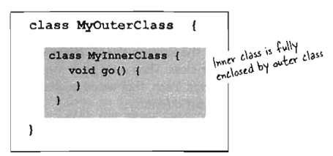
Inner class
You can have one class nested inside another.

Slide 31
Very handy
Inner class get special access to its outer class. Even the private.
Inner class have most benefit of normal class, but with special access right

Slide 32
Nutshell
An inner class can use all the methods and variables of other class even the private one
The inner class get to use those methods and variables as if the methods and variables were declared within the inner class

Slide 33
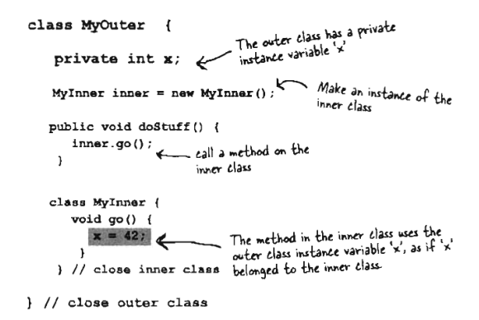
Example

Slide 34
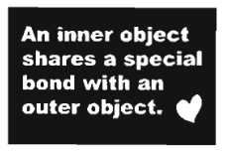
Inner class instance must be tied to an outer instance
We are really talking about instance of inner class accessing something in instance of outer class

Slide 35
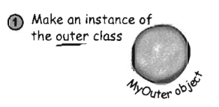
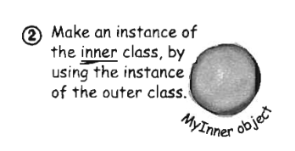
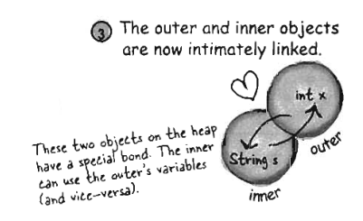
3 steps

Slide 36
Example

Slide 37
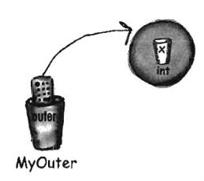
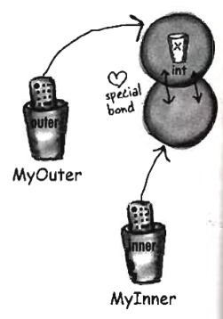
Example

Slide 38
Thank You

